Slide 1
Azure Pipelines
WWW.DTHINKS.IT
INFO@DTHINKS.IT
Digital Thinks S.r.l.
P.zza Indro Montanelli, 20 - 20099 Sesto San Giovanni (MI) - +39 028721132

Slide 2





Chi sono
Antonio Liccardi
Chief Technology Officer @ Blexin
Microsoft MVP for Developer Technologies
Founder DotNetCampania
Trainer / Speaker / Blogger
antonio-liccardi-57389a22
blexin.com/it-IT/posts
turibbio
turibbio
@turibbio

Slide 3
The Concept of Pipelines in DevOps
Build Automation and Continuous Integration
Test Automation
Deployment Automation
A pipeline enables a constant flow of changes into production via an automated software production line
Pipelines create a repeatable, reliable and incrementally improving process for taking software from concept to customer
Pipelines require infrastructure, this infrastructure will have a direct impact on the effectiveness of the pipeline

Slide 4
Azure Pipelines
Azure Pipelines is a cloud service that you can use to automatically build and test your code project and make it available to other users
Works great with Continuous Integration and Continuous Delivery
Work with any language or platform - Python, Java, PHP, Ruby, C#, and Go
Deploy to different types of targets at the same time
Integrate with Azure deployments - container registries, virtual machines, Azure services, or any on-premises or cloud target (Microsoft Azure, Google Cloud, or Amazon cloud services)
Build on Windows, Linux, or Mac machines
Integrate with GitHub
Work with open-source projects

Slide 5
Microsoft vs Self-Hosted Agents
You need at least one agent to build or deploy your project
An agent is installable software that runs one build or deployment job at a time
Two types of agents:
Microsoft-hosted agents - Automatically take care of maintenance and upgrades. Each time you run a pipeline, you get a fresh virtual machine. The virtual machine is discarded after one use.
Self-hosted agents – You take care of maintenance and upgrades. Give you more control to install dependent software needed. You can install the agent on Linux, macOS, Windows machines, or even in a Linux Docker container.

Slide 6
Agent Pools
Pool A
Pool B
Machine
Machine
Agent
Agent
Agent
Agent
Agent
You can organize agents into agent pools
An agent pool defines the sharing boundary
In Azure Pipelines, agent pools are scoped to the Azure DevOps organization; so you can share an agent pool across projects

Slide 7
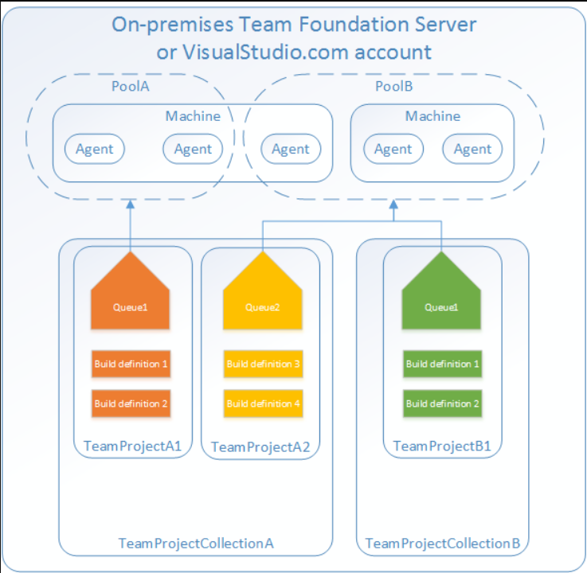
Typical Situations for Agent Pools
You're a member of a project and you want to use a set of machines owned by your team for running build and deployment jobs
You're a member of the infrastructure team and would like to set up a pool of agents for use in all projects
You want to share a set of agent machines with multiple projects, but not all of them

Slide 8
Security of Agent Pools
Roles are defined on each agent pool, and membership in these roles governs what operations you can perform on an agent pool
Role | Purpose
Reader | Members of this role can view the organization agent pool as well as agents. You typically use this to add operators that are responsible for monitoring the agents and their health.
Service Account | Members of this role can use the organization agent pool to create a project agent pool in a project. If you follow the guidelines above for creating new project agent pools, you typically do not have to add any members here.
Administrator | In addition to all the above permissions, members of this role can register or unregister agents from the organization agent pool. They can also refer to the organization agent pool when creating a project agent pool in a project. Finally, they can also manage membership for all roles of the organization agent pool. The user that created the organization agent pool is automatically added to the Administrator role for that pool.

Slide 9
Microsoft-Hosted vs Self-Hosted
A free tier of service by default for every organization
Service is based on public vs private projects
Microsoft-hosted CI/CD
Run your builds and releases on machines that Microsoft manages
Jobs run on the pool of hosted agents
There are time limits on these jobs
Self-hosted CI/CD
Azure Pipelines orchestrates your builds and releases
Use your own machines to run the builds and releases
There are no time limits on these jobs

Slide 10
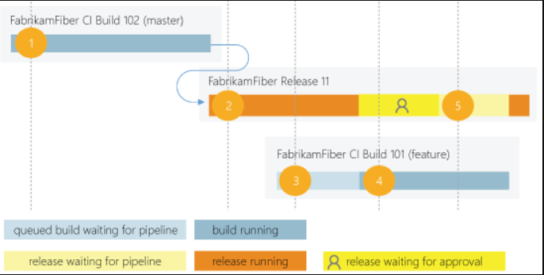
Parallel Jobs
This is a simple example of a Microsoft-hosted parallel job
Users can collectively run only one build or release job at a time, additional jobs are queued
A release consumes a parallel job only when it's being actively deployed to a stage

Slide 11
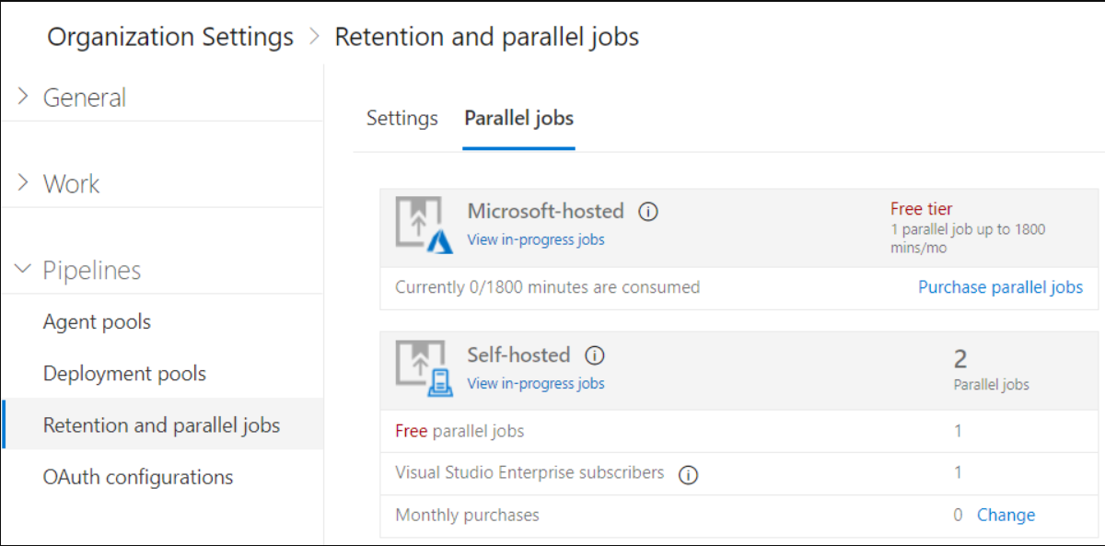
Estimating Parallel Jobs
Determine how many parallel jobs you need
Simple estimates vs Detailed estimates
You can display all the builds and releases
Parallel jobs are purchased at the organization level, and are shared by all projects

Slide 12
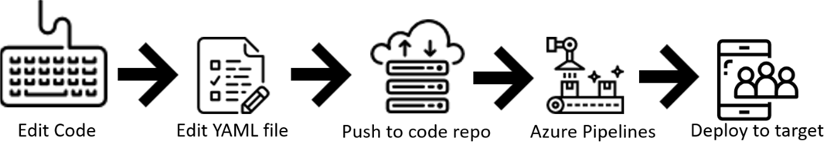
Azure Pipelines and YAML
Configure your pipelines in a YAML file that exists alongside your code
Configure Azure Pipelines to use your Git repo
Edit your azure-pipelines.yml file to define your build
Push your code to your version control repository
Your code is now updated, built, tested, and packaged

Slide 13
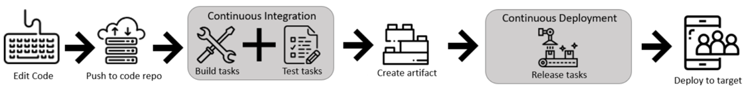
Azure Pipelines and Visual Designer
Configure your pipelines with the Visual Designer
Create and configure your build and release pipelines
Push your code to your version control repository
The build creates an artifact that's used by the rest of your pipeline
Your code is now updated, built, tested, and packaged

Slide 14
Introduction to Continuous Integration
Continuous Integration (CI) is the process of automating the build and testing of code.
CI encourages developers to share their code and unit tests by merging their changes into the shared version control repository.
When a change is detected it triggers an automated build system. The code is built using a build definition. Developers respond to any issues or bugs.
CI keeps the master branch clean ensuring bugs are caught earlier in the development cycle, which makes them less expensive to fix.

Slide 15
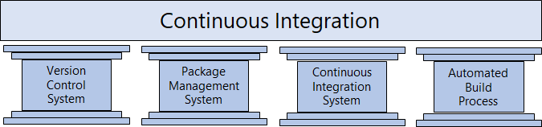
The Four Pillars of Continuous Integration
A Version Control System manages changes to your source code over time.
A Package Management System is used to install, uninstall and manage software packages.
A Continuous Integration System merges all developer working copies to a shared mainline several times a day.
An Automated Build Process creates a software build including compiling, packaging, and running automated tests.

Slide 16
Benefits of Continuous Integration
Improving code quality based on rapid feedback
Triggering automated testing for every code change
Reducing build times for rapid feedback and early detection of problems (risk reduction)
Better management of technical debt and code analysis
Reducing long, difficult, and bug-inducing merges
Increasing confidence in codebase health long before production deployment
Rapid feedback to the developer

Slide 17
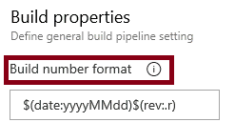
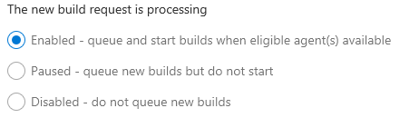
Build Number Formatting and Build Status
Build number formatting
Build status (enabled, paused, disabled)

Slide 18
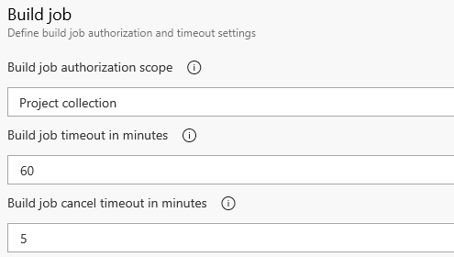

Authorization and Timeouts, and Badges
Authorization and Timeouts (scope, job timeout, cancel job timeout)
Badges

Slide 19
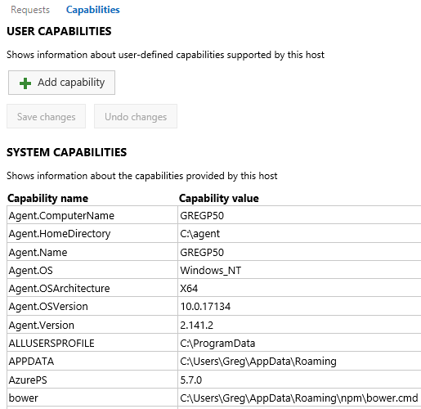
Configuring Agent Demands
User Capabilities
System Capabilities
Agents can have different authorization and timeout settings

Slide 20
Implementing Multi-Agent Builds
Adding multiple jobs to a pipeline lets you:
Break your pipeline into sections that need different agent pools, or self-hosted agents
Publish artifacts in one job and consume them in one or more subsequent jobs
Build faster by running multiple jobs in parallel
Enable conditional execution of tasks
✔️ You can configure the number of parallel jobs

Slide 21
Anatomy of a Pipeline
Name – though often this is skipped (if it is skipped, a date-based name is generated automatically)
Trigger – more on triggers later, but without an explicity trigger, there’s an implicit "trigger on every commit to any path from any branch in this repo"
Variables – these are "inline" variables (more on other types of variables later)
Job – every pipeline must have at least one job
Pool – you configure which pool (queue) the job must run on
Checkout – the "checkout: self" tells the job which repository (or repositories if there are multiple checkouts) to checkout for this job
Steps – the actual tasks that need to be executed: in this case a "script" task (script is an alias) that can run inline scripts

Slide 22
Pipeline Structure
Pipeline – one or more stages that describe a CI/CD process
Stage – collection of related jobs
Job – collection of steps run by an agent on a server
Step – linear sequence of operations that make up a job
Tasks – building blocks of a pipeline

Slide 23
Templates
Azure Pipelines supports 4 kinds of templates
Stage
Job
Step
Variable

Slide 24
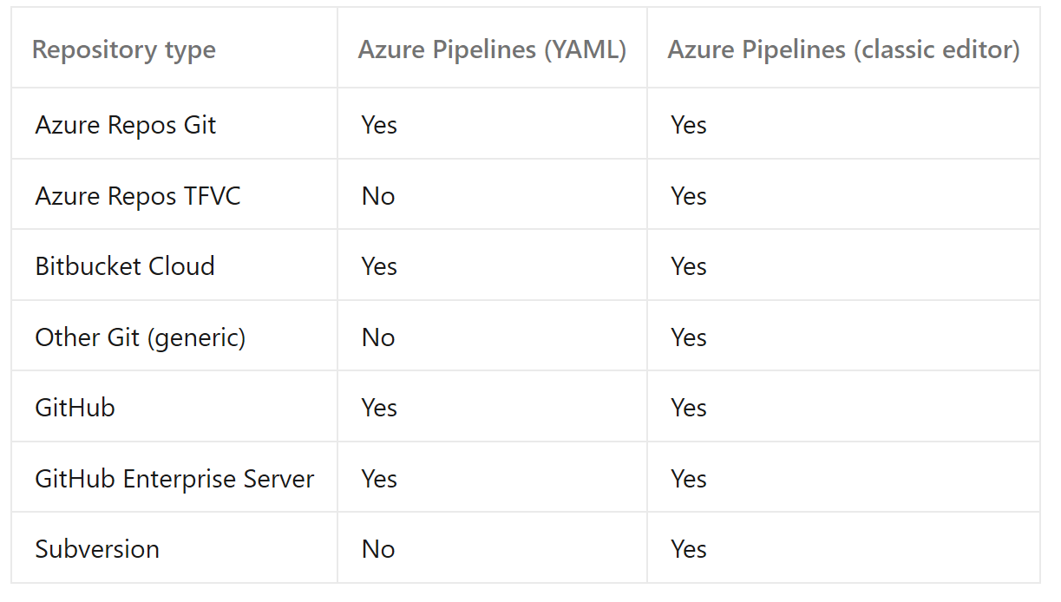
Source Control Types Supported by Azure Pipelines
Repository types supported:

Slide 25
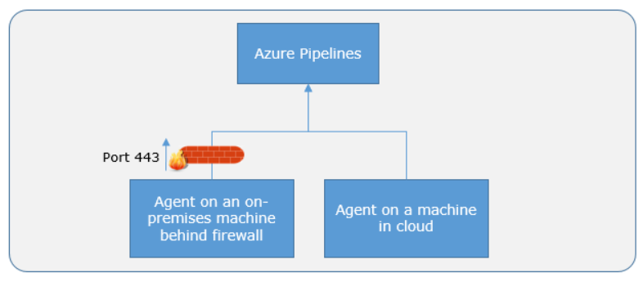
Communication with Azure Pipelines
The agent determines which job it needs to run, and to report the logs and job status
Communication is always initiated by the agent
All the messages from the agent to Azure Pipelines are over HTTPS

Slide 26
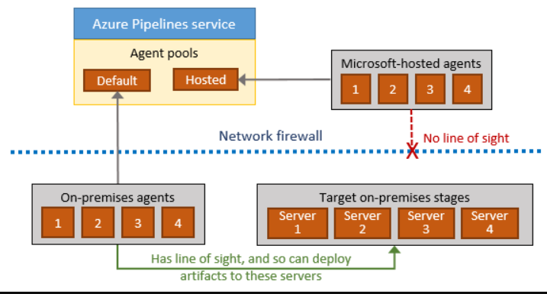
Communication to Deploy to Target Servers
Agent must have "line of sight" connectivity to servers
Microsoft-hosted agent pools, by default, have connectivity to Azure websites and servers running in Azure
You may need to manually configure connectivity

Slide 27
Continuous Integration
DEMO

Slide 28
What is Continuous Delivery The Eight Principles of Continuous Delivery
The process for releasing/deploying software MUST be repeatable and reliable.
Automate everything!
If somethings difficult or painful, do it more often.
Keep everything in source control.
Done means “released”.
Build quality in!
Everybody has responsibility for the release process.
Improve continuously.

Slide 29
Releases And Deployments
Release and deployment are often coupled
Release is not the same as a deployment
Separate that in functional and technical release
Functional release is exposing features to customers
Technical release is deploying functionality

Slide 30
Feature toggles
What is it?
Mechanism to separate feature deployment from feature exposure
A.k.a. feature flippers, feature flags, feature switch, conditional feature, etc.
Why do you need it?
It enables you to give control back to the business on when to release the feature
Enables A/B testing, canary releases and dark launching
It provides an alternative to keeping multiple branches in version control
Enables change without redeployment

Slide 31
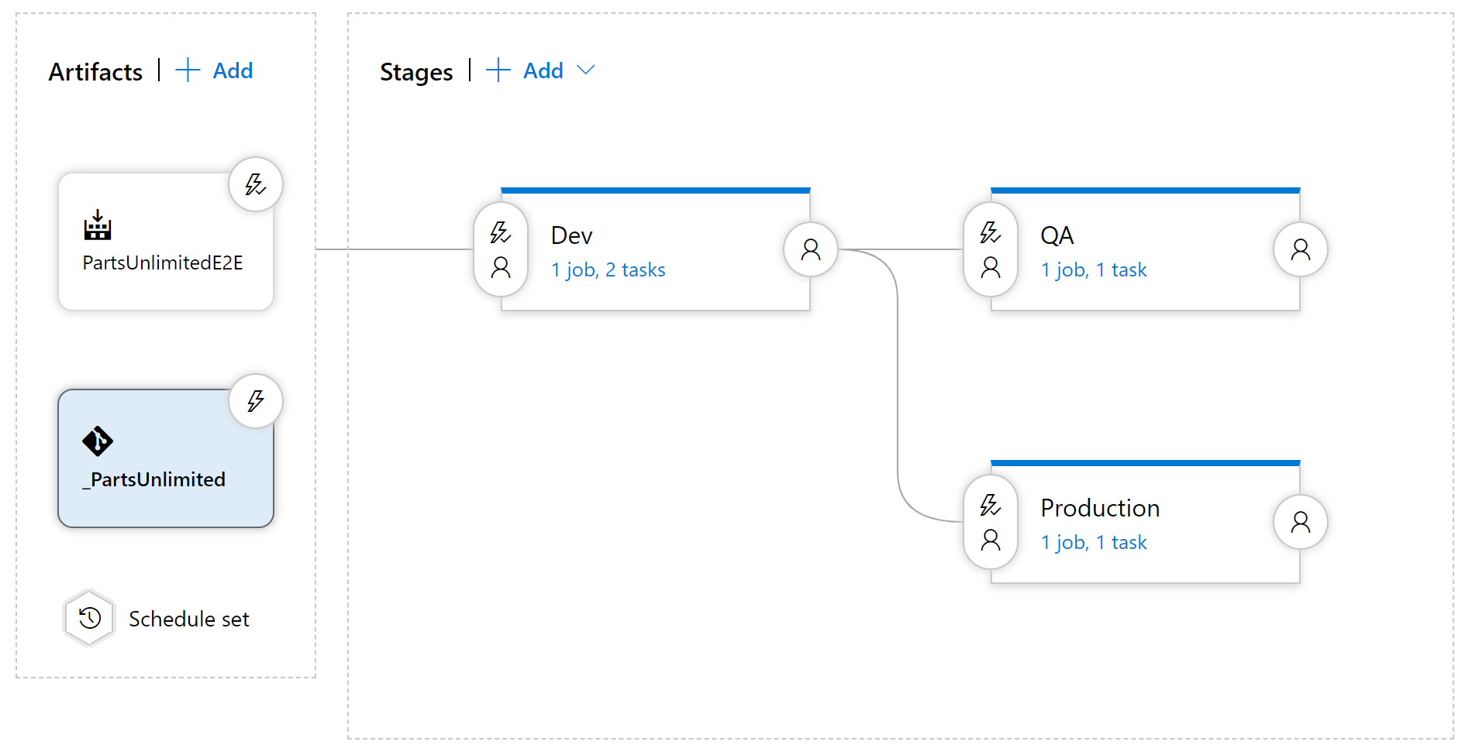
Components in a release pipeline

Slide 32
Deployment Stages
What is a stage?
Many different terms used in various release tools
Stages/environment
It is a dedicated place where people can fulfill their needs
What is your target environment?
Long-lived or short-lived environments
Purpose of an environment
Feature release and bugfix

Slide 33
Delivery cadence - three types of triggers
Continuous Deployment Trigger
Scheduled Trigger
Manual Trigger

Slide 34


Release Approvals
Release approvals are not to control *how*, but control *if* you want to deliver multiple times a day.
Manual Approvals help in building trust about the automated release process

Slide 35
Release Gates
Release gates give you additional control over the start and completion of the deployment pipeline. They can usually be set up as a pre-deployment and post-deployment condition and can do validation with other automated systems until specific requirements are verified.

Slide 36
Release Gate Examples
Incident and issues management
Notification of users by integration with collaboration systems
Quality validation
Security scan on artifacts
User experience relative to baseline
Change management
Infrastructure health

Slide 37
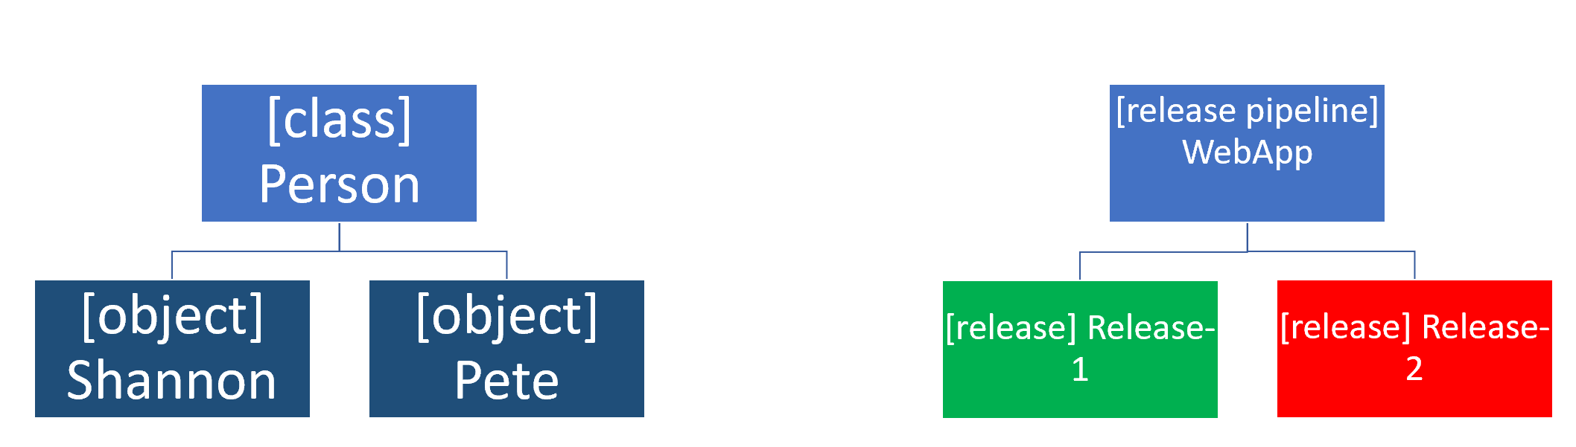
Release and Release Process

Slide 38
Release and Release Process
The release pipeline contains all the steps that you walk through when you move your artifact, that comes from one of the artifact sources
A release is a package or container that holds a versioned set of artifacts specified in a release pipeline in your CI/CD process. It includes a snapshot of all the information required to carry out all the tasks and actions in the release pipeline, such as the stages (or environments), the tasks for each one, the values of task parameters and variables, and the release policies such as triggers, approvers, and release queuing options. There can be multiple releases from one release pipeline (or release process).

Slide 39
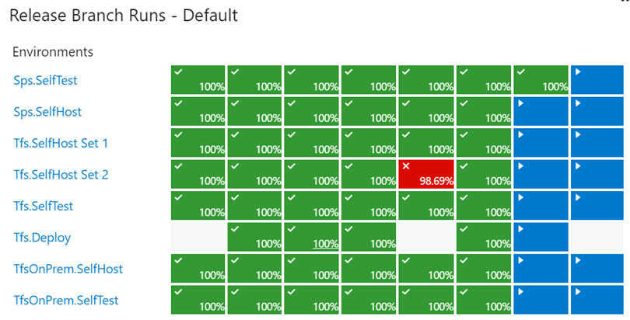
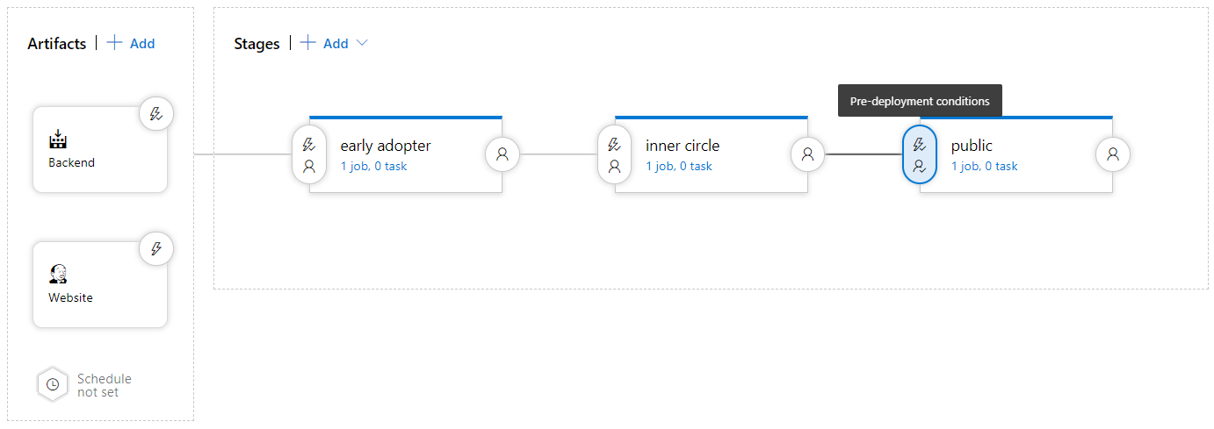
How to measure quality of your release process
Visualize your release process
Symptoms of broken process (every second day, only after rerun, never ending up in last stage)
Dashboard widgets

Slide 40
Quality Gates
A quality gate is the best way to enforce a quality policy in your organization. It's there to answer one question: can I deliver my application to production or not?

Slide 41
Using Release Gates to protect quality
No new blocker issues
Code coverage on new code greater than 80%
No license violations
No vulnerabilities in dependencies
No new technical debt introduced
Compliance checks
Are there work items linked to the release?
Is the release started by someone else as the code committer?
Is the performance not affected after a new release?

Slide 42
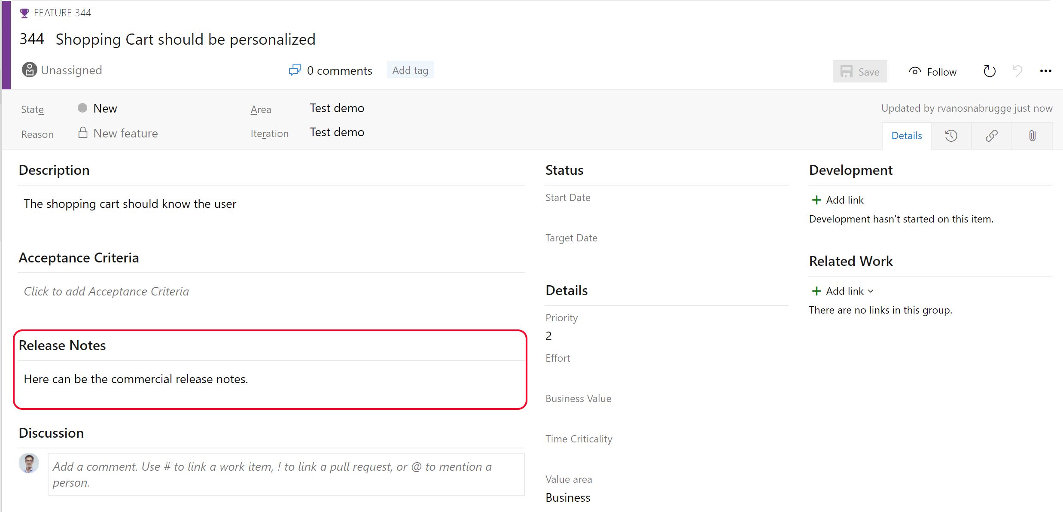
Release notes and Documentation
Technical or Functional Documentation?
Where to store Documentation
Document Store
Wiki
In the code base
In a Work Item

Slide 43
Deployment patterns
Dev
Test
Staging
Production
A deployment pattern is a way of how you choose to move your application to production.
Traditional Deployment Patterns (DTAP)
Modern Deployment Patterns

Slide 44
Modern Deployment Patterns
Blue-Green Deployment
Canary Release
Dark Launching
Progressive Exposure Deployment

Slide 45
Release Management Tools
Tools that can do Build and Continuous Integration and Deployment
Tools that can do Release Management

Slide 46
Definitions and Glossary
Term | Description | Synonym
Stage | an isolated and independent target for deployment | Environment
Job | A phase in the release pipeline that can run simultaneously with other phases on different Operating Systems | Phases
Agent | The program that runs the build or release
Build & Release Task | Tasks are units of executable code used to perform designated actions in a specified order. | Action, Plugin, App
Release pipeline | The process that runs when deploying an artifact. Including triggers, approvals and gates | release process, pipeline, release definition
CI/CD | Continuous Integration / Continuous Deployment
Release Gate | An automated check that approves the continuation | Quality Gate, Automatic Approval
Service Connection | A secure connection to an environment or service | Service Endpoint

Slide 47
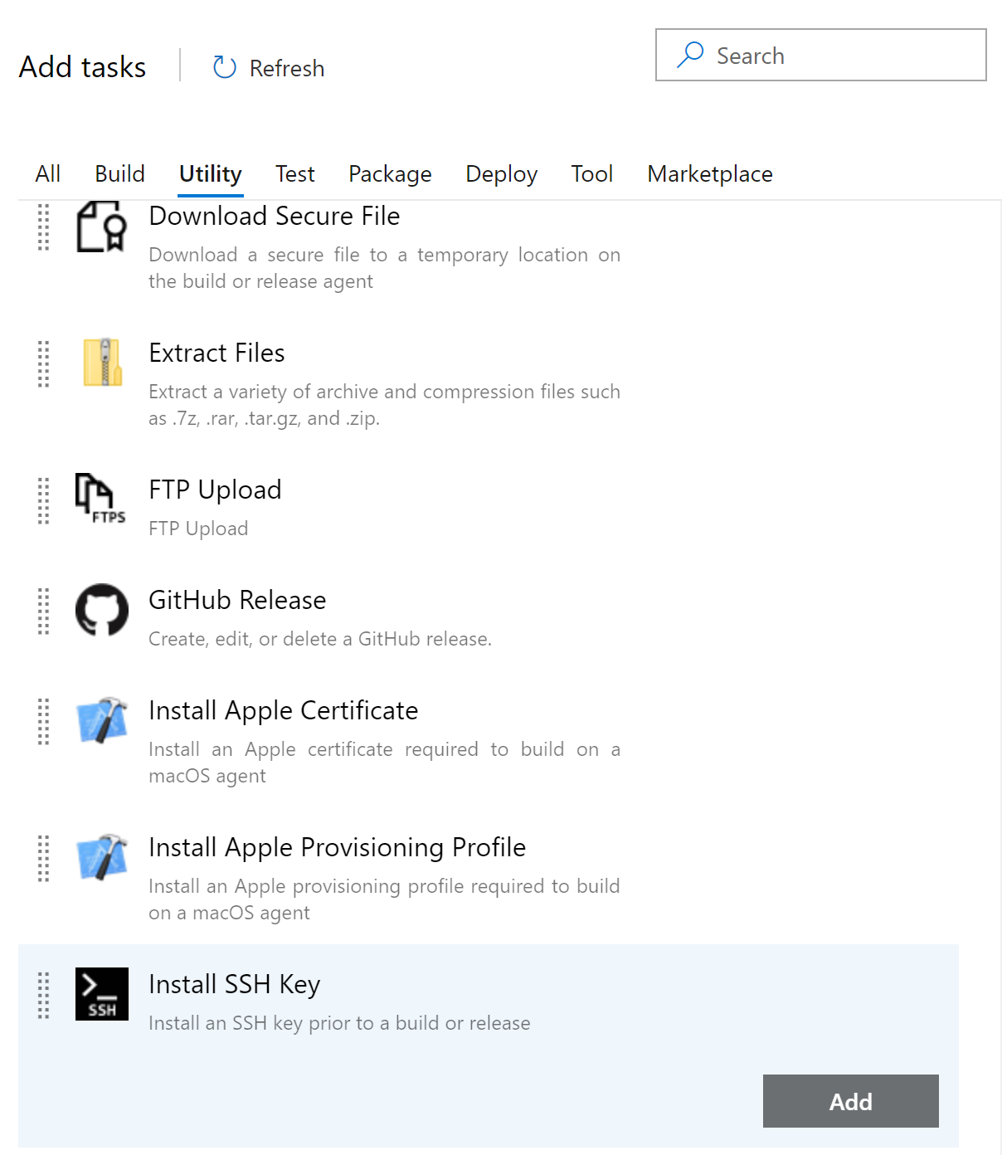
Build and Release Tasks
Units of executable code used to perform designated actions in a specified order
Tasks building, testing, running utilities, packaging, and deploying
Extensible model
Community tasks available in marketplace

Slide 48
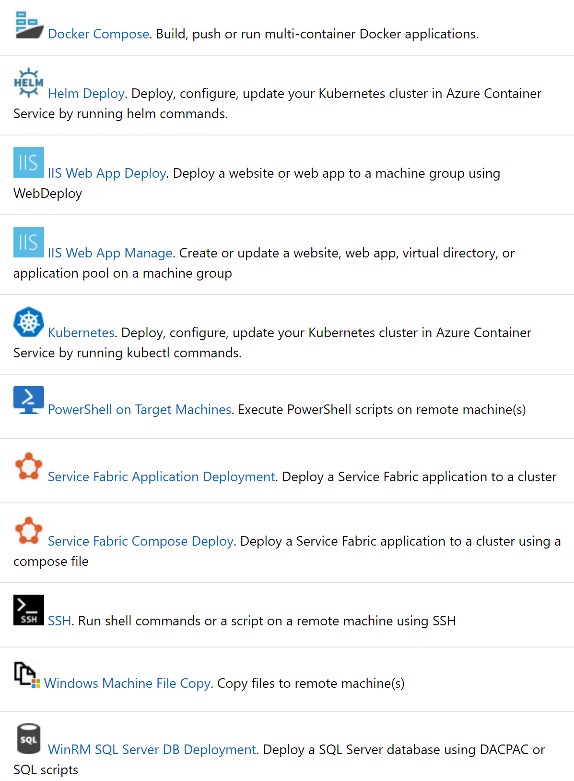
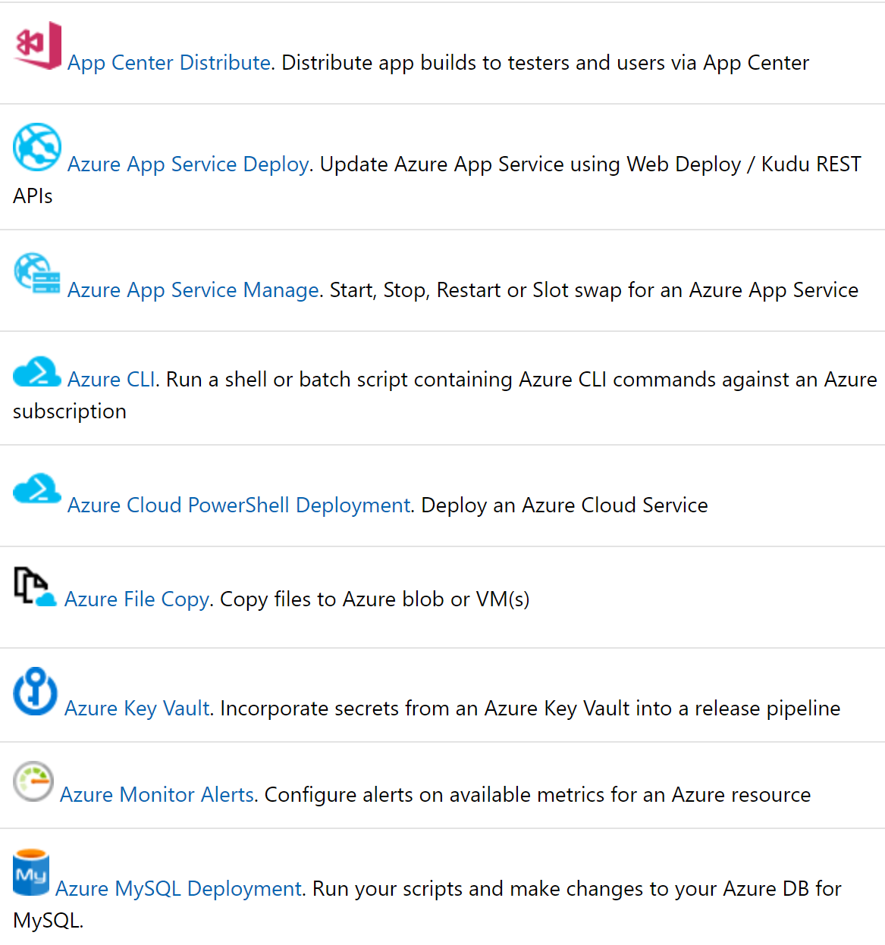
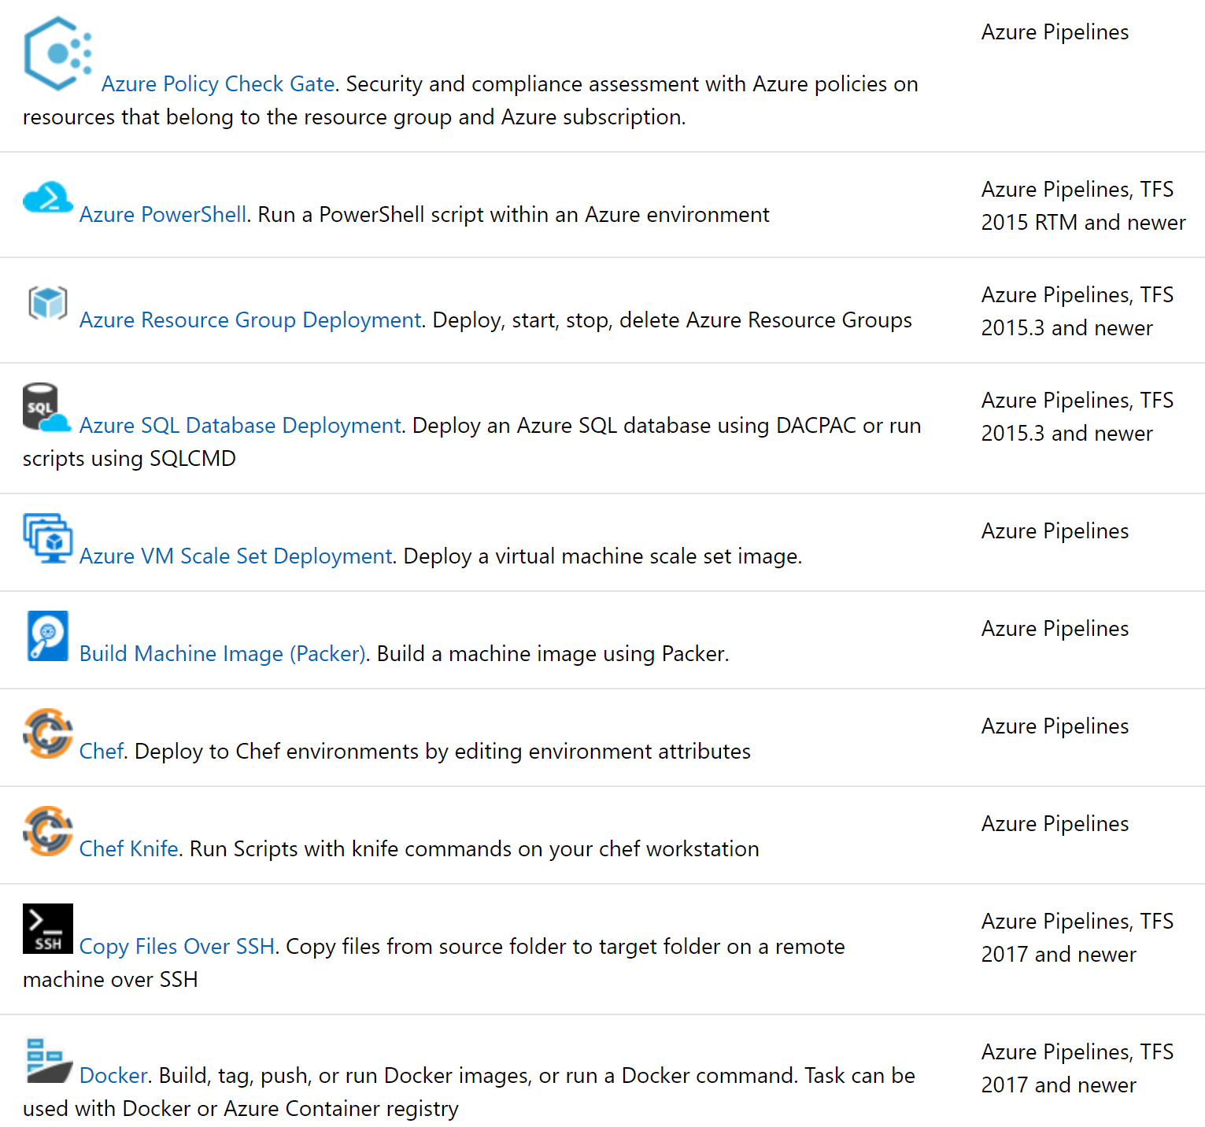
Important Deployment Tasks

Slide 49
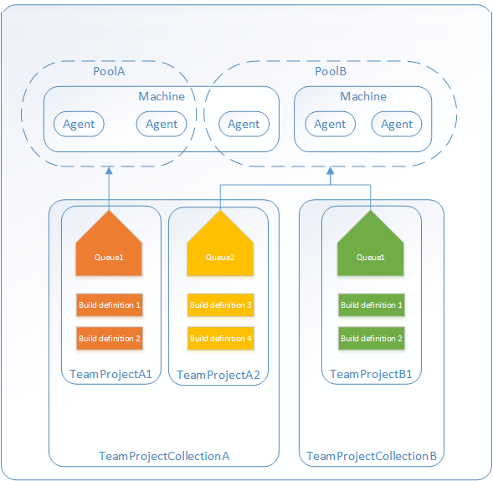
Agents, Agent Pools and Queues
Agents are tasked with performing the builds and releases
Agent pools are used to organize and define permission boundaries around your agents
Agent queue provides access to a pool of agents.

Slide 50
Private and Hosted Agents
Hosted agents. These agents exist within their own hosted pool and are maintained and upgraded by the vendor. Hosted agents have specific limitations and advantages:
Hosted agents have no cost and are immediately available, and have most common software and libraries installed.
Do not have an interactive mode.
Do not allow administrative privilege or allow logon.
Private (or Custom) agents. Private agents are provisioned on private virtual machines (VMs) and are custom built to accommodate the project's needs.

Slide 51
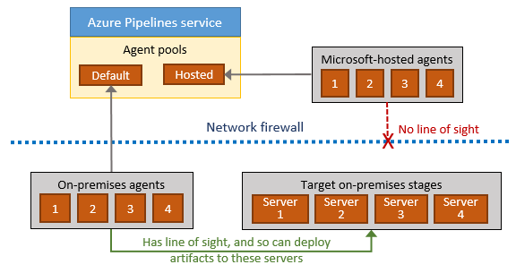
Deployment Groups
A deployment group is a logical set of deployment target machines that have agents installed on each one.
Can solve the firewall issues because you pull sources from a central server
Specify the security context and runtime targets for the agents.
Let you view live logs for each server as a deployment takes place.
Enable you to use machine tags to limit deployment to specific sets of target servers.

Slide 52
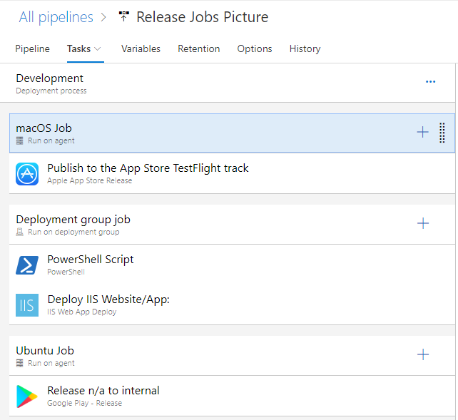
Release Agent Jobs
A job is a series of tasks that run sequentially on the same target
Can be combined in one pipeline to enable multi-platform deployment
E.g. Deploy .Net backend via Windows, IoS app via MacOS and Angular frontend via Linux
Jobs run on the host machine where the agent is installed

Slide 53
Using Release Jobs
Jobs or Agent Jobs
Server or Agentless Jobs
Container Jobs
Deployment Group Jobs

Slide 54
Multi-Configuration and Multi-Agent
Multi-configuration: Run the same set of tasks on multiple configurations
Run the release once with configuration Setting A on WebApp A and setting B for WebApp B
Deploy to different geographic regions.
Multi-configuration testing: run a set of tests in parallel - once for each test configuration.
Multi-agent: Run the same set of tasks on multiple agents using the specified number of agents
Deploy same bits to a farm of servers

Slide 55
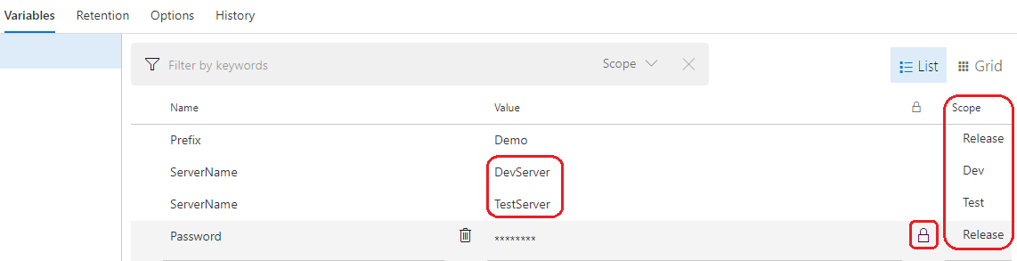
Release Variables
Predefined Variables
Release pipeline variables
Stage Variables
Variable groups
Normal and Secret variables

Slide 56
Provision and Configure Target Environments
On-Premises servers
Cloud servers or Infrastructure as a Service (IaaS). For example Virtual machines or networks.
Platform as a Service (PaaS) and Functions as a Service (FaaS). For example Web apps or storage accounts.
Clusters.

Slide 57
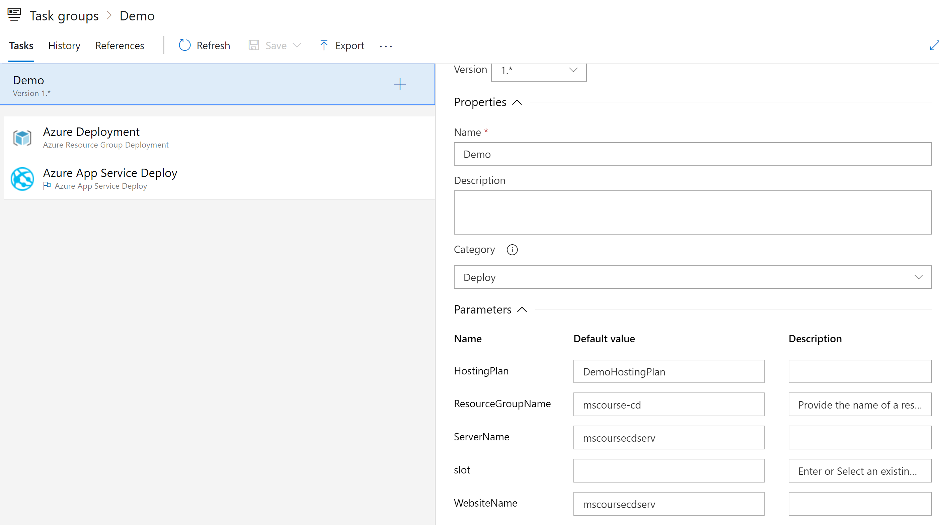
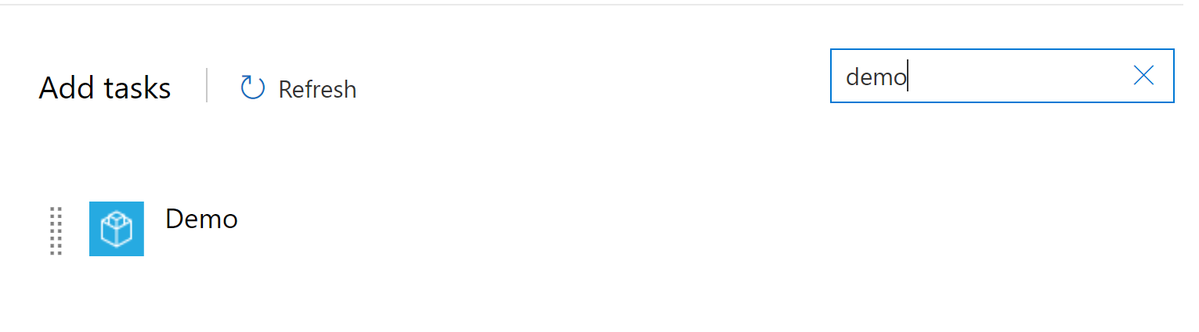
Task Groups
Encapsulate a sequence of tasks in one reusable task
Parameterization of task group to make reuse easier
Standardize and centrally manage deployment steps for all your applications

Slide 58
Variable Groups
58
Store the username and password for a shared server
Store a share connection string
Store the geolocation of an application
Store all settings for a specific application
A variable group is used to store values that you want to make available across multiple builds and release pipelines.

Slide 59
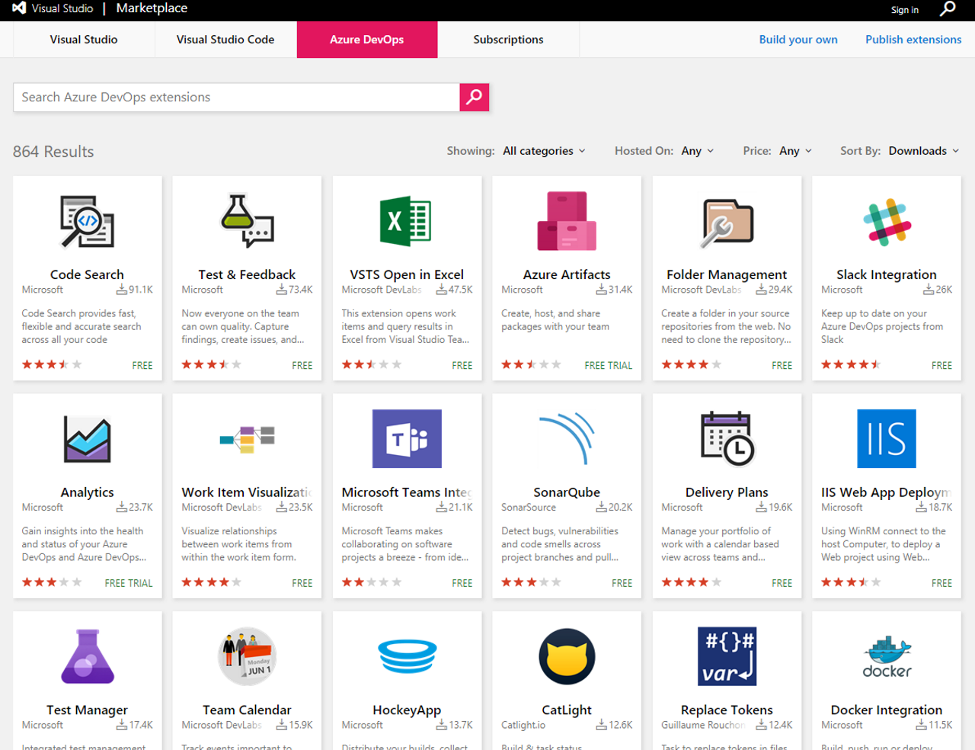
Custom build/release tasks
Private or public accessible
Access to variables that are otherwise not accessible
Use and reuse secure endpoint to a target server
Safely and efficiently distribute across your whole organization
Users do not see implementation details.

Slide 60
Secrets are needed
Secrets to access the target environment (servers, storage accounts)
Secrets to access resources (connections strings, tokens, username/passwords)
Secrets that your application uses (config files)

Slide 61
Secrets in your release pipeline
61
Service Connections
Using secret variables
Storing secrets in a key vault
Retrieve with a variable group
Accessing Keyvault from within the pipeline

Slide 62
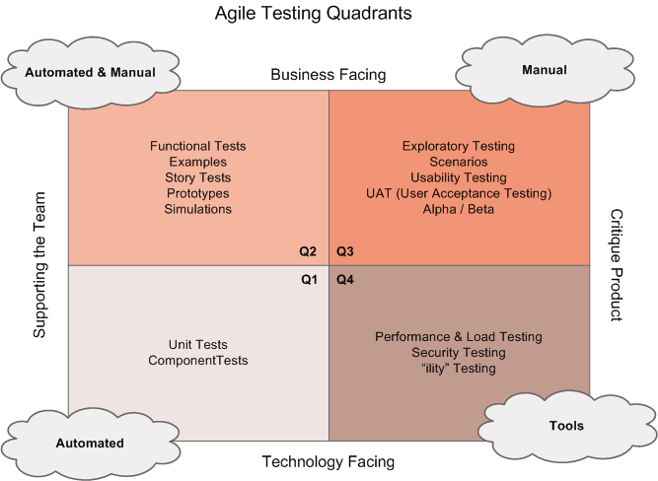
Configure Automated Integration and Functional Test Automation
Do not automate all your manual tests
Rethink test strategy
Tests should be written at the lowest level possible
Write once, run anywhere including production system
Product is designed for testability
Test code is product code, only reliable tests survive
Test ownership follows product ownership

Slide 63
Setting up Test Infrastructure
Test Agents are needed to run tests on target servers
Run on your own servers or target servers
Run in the cloud

Slide 64
Setting up and Running Availability Tests
Create Health endpoints in your application
Use tools, e.g. availability tests in Application Insights, to test health endpoints
Two types of availability tests
URL ping test
Multi-step web test

Slide 65
Release Gates
As a quality gate or as an automatic approval
Can be configured pre- and post stage
Keeps evaluating for success for a timeframe
Ships out of the box in Azure DevOps
Different types of Release Gate
Call an Azure Function
Call a REST API
Azure Monitor
Query Work Items
Publish to Azure Service Bus

Slide 66
Events, Subscriptions, and Notifications
Actions in Azure DevOps trigger events
Users can subscribe to events and get notified
Calling a SOAP url
Getting an email
Notifications can be managed centrally and personally

Slide 67
Service Hooks
Service hooks enable you to perform tasks on other services when events happen
Out of the Box integrations
Build and release | Collaborate | Customer support | Plan and track | Integrate
AppVeyor | Campfire | UserVoice | Trello | Azure Service Bus
Bamboo | Flowdock | Zendesk |  | Azure Storage
Jenkins | HipChat |  |  | Web Hooks
MyGet | Hubot |  |  | Zapier
Slack

Slide 68
Azure Pipelines
DEMO

Slide 69
Deployment Patterns

Slide 70

Definitions of microservices
Small and focused on doing one thing well
Autonomous
“Loosely coupled service oriented architecture with bounded contexts” Adrian Cockcroft (Netflix)
“… services are independently deployable and scalable, each service also provides a firm module boundary, even allowing for different services to be written in different programming languages.” Martin Fowler (Thoughtworks)
“SOA done right” Anonymous

Slide 71
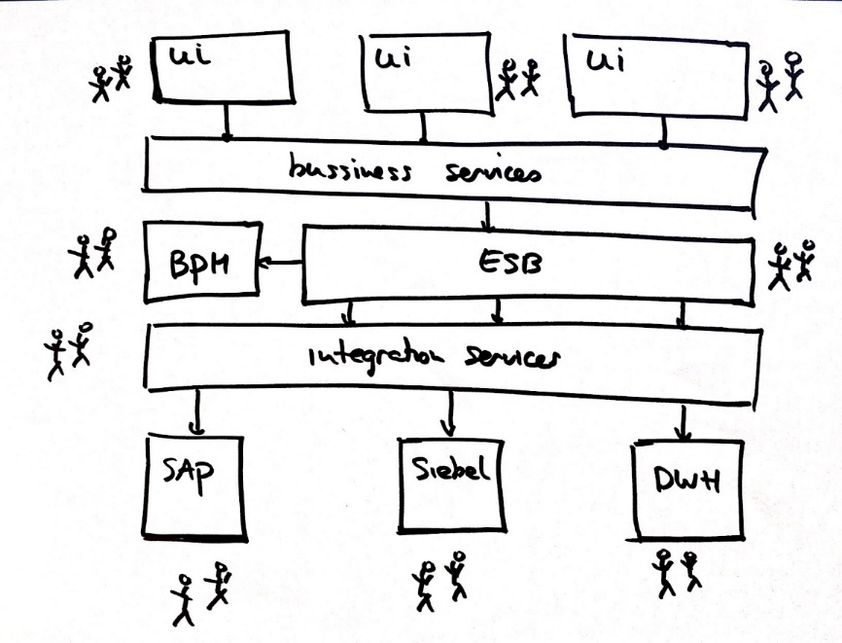
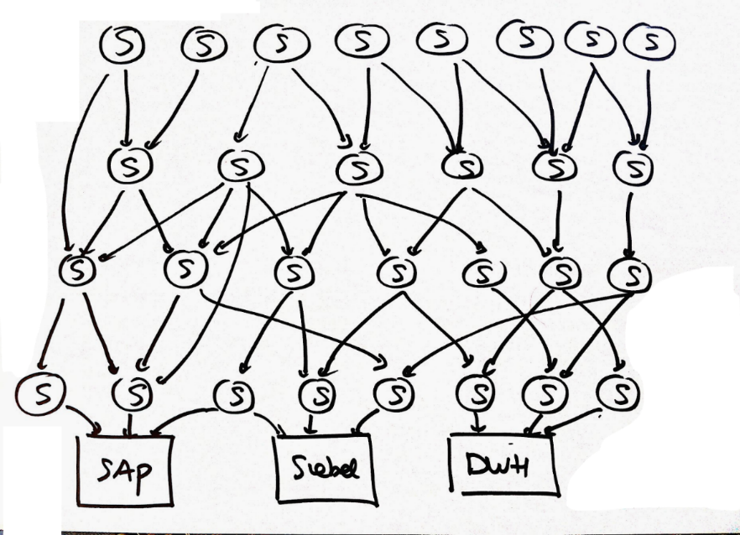
Microservices architecture

Slide 72
Deployment Patterns
Dev
Test
Staging
Production
“Classical” Deployment Patterns

Slide 73
Modern Practices
Blue Green Deployments
Canary Releases
Dark Launching
A/B Testing
Progressive Exposure Deployment / Ring Based Deployments
Enabled by Feature Toggles

Slide 74



Blue Green deployment
www.production.com
Load Balancer
Swap
Blue
www.temp.production.com
Green

Slide 75
Deployment slots
What is it?
A way to set up multiple environments and swap between environments
Why do you need it?
When you want to deploy with zero downtime
When you need to test in production
When you want easy rollback

Slide 76
Feature toggles
What is it?
Mechanism to separate feature deployment from feature exposure
A.k.a. feature flippers, feature flags, feature switch, conditional feature, etc.
Why do you need it?
It enables you to give control back to the business on when to release the feature
Enables A/B testing, canary releases and dark launching
It provides an alternative to keeping multiple branches in version control
Enables change without redeployment

Slide 77
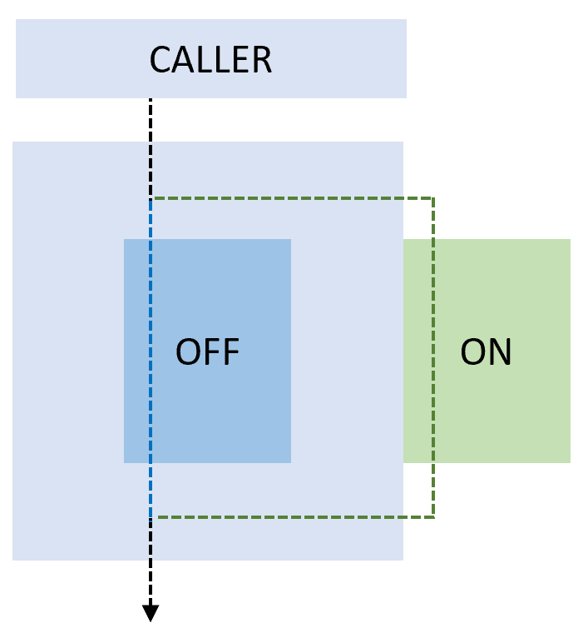
Feature toggle
ON
OFF

Slide 78
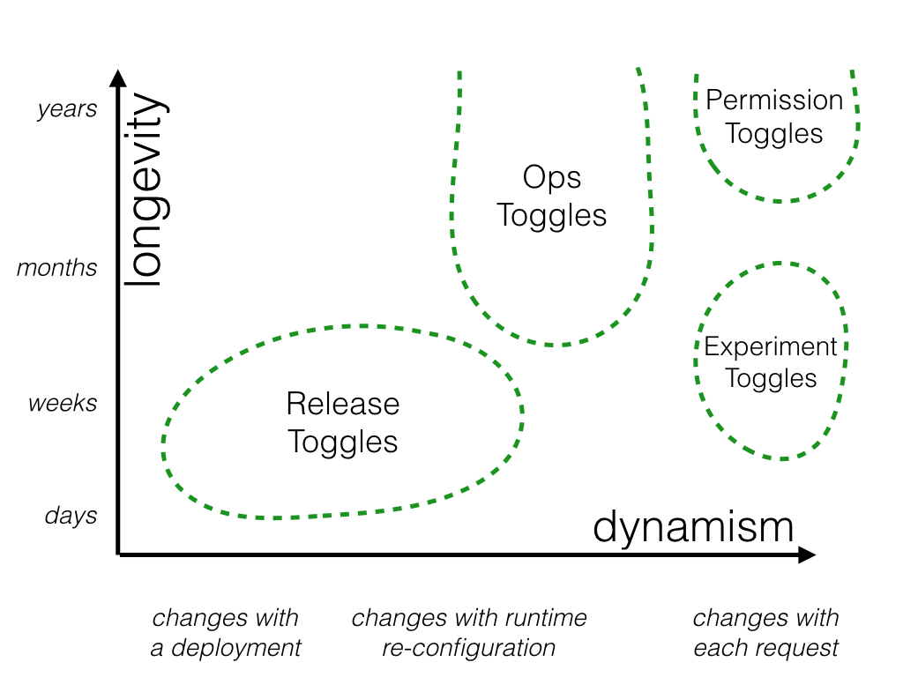
Feature Toggle Maintenance
Feature toggles need to be maintained!
Remove them when you can
It is technical debt if you keep them around

Slide 79

Canary release
What is it?
Releasing a feature to a limited subset of end users
Why do you need it?
Validates there is no break
When you want to gradually roll out a feature to ensure enough capacity

Slide 80
Canary release
How do you do it?
Use a combination of feature toggles, traffic routing and deployment slots
Random selection of users:
Setup deployment slots with feature enable
Route %traffic to the instance with the new feature enabled
Target specific user segment
Use feature toggle to enable feature for specific user segment

Slide 81
Canary Release
Load Balancer
v1
v1
v1
v1

Slide 82
Traffic Manager
What is it?
Traffic manager provides the ability to route traffic between Azure app services
Within an app service, routes traffic between deployment slots
Why do you need it?
It enables failover and load distribution capabilities
It enables you to deploy to a slot and then slowly move traffic over to the other slot

Slide 83
Traffic manager options
Traffic manager provides four options:
Route traffic based on availability
Route traffic round robin
Route traffic based on weight
Route traffic based on latency
In the context of continuous delivery, we are most interested in option 1 and 3

Slide 84
Dark Launching
Dark Launching is in many ways similar to Canary Testing. However, the difference here is that you are looking to assess the response of users to new features in your frontend, rather than testing the performance of the backend. The idea is that rather than launch a new feature for all users, you instead release it to a small set of users. Usually, these users aren’t aware they are being used as guinea pigs for the new feature and often you don’t even highlight the new feature to them, hence the term “Dark” launching.

Slide 85
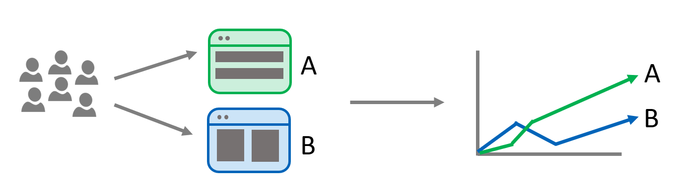
A/B Testing
A/B testing is mostly an experiment where two or more variants of a page are shown to users at random, and statistical analysis is used to determine which variation performs better for a given conversion goal.

Slide 86
A/B Testing
A/B testing is mostly an experiment where two or more variants of a page are shown to users at random, and statistical analysis is used to determine which variation performs better for a given conversion goal.

Slide 87
Why A/B Testing
Experiment on features and usage
Improve conversion rate
Continuous experiments
Measure impact of change

Slide 88
What is Progressive Exposure Deployment
A.k.a. Ring Based Deployment
Deploy changes to risk tolerant customers first, progressively roll out to larger and larger sets of customers
Automated health checks
Possibility to stop or roll back

Slide 89
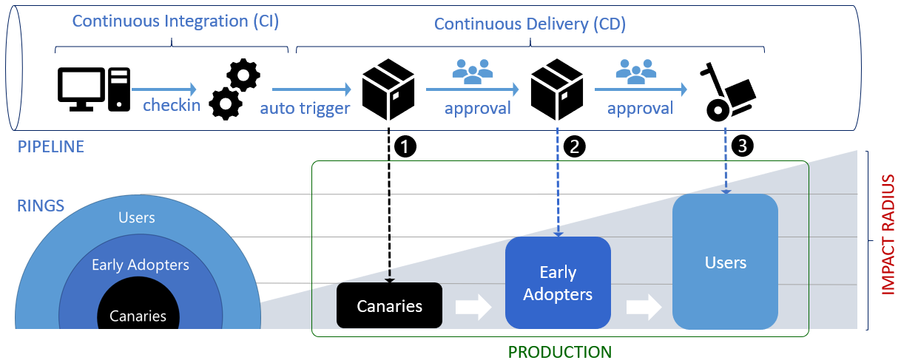
CI/CD with deployment rings

Slide 90
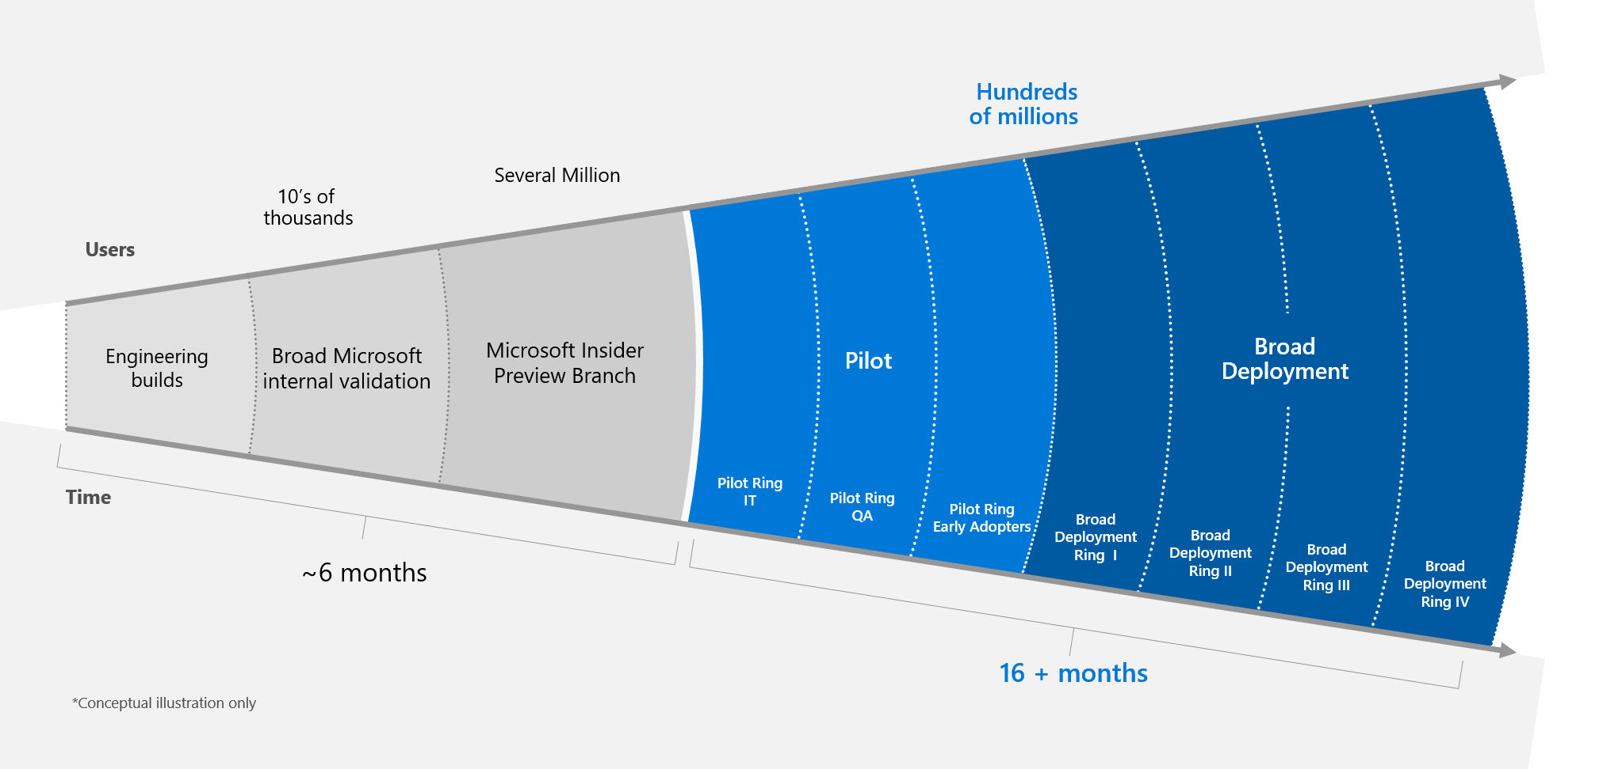
Example: Windows team

Slide 91
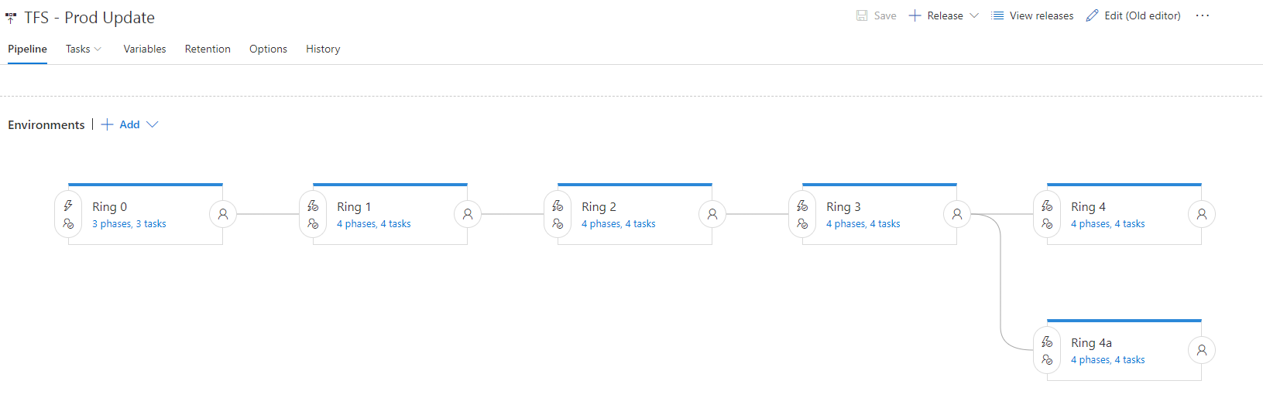
Deployment Definition

Slide 92
Continuous Deployment & Patterns
DEMO

